Slide 1
Ridge Regression
Imposing penalty on the size of coeffients

Slide 2
Cross validation process

Slide 3
Variable: standardize/norm features
Why it is useful?
As we are using lambda to penalize weights/coefficients of each feature, if the units are quite different, then the shrinking of coefficients are not at the same scale or same order of magnitude.
I.e. sum of square of weights: height measured in meter or kilometer are different.

Slide 4
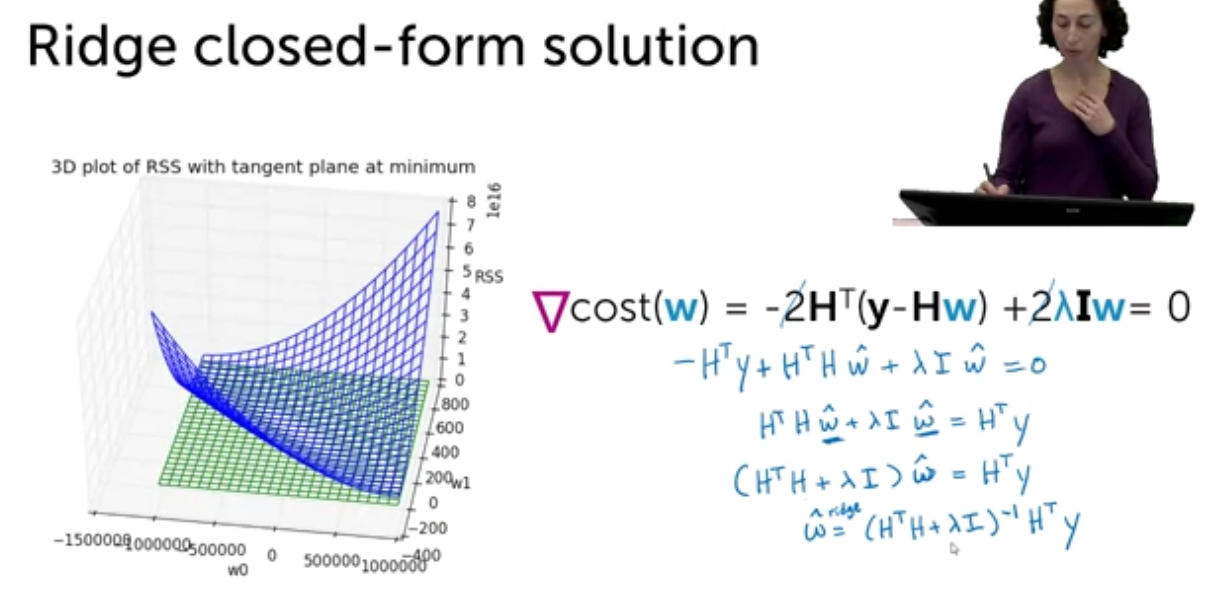
Solution 1: closed form solution

Slide 5
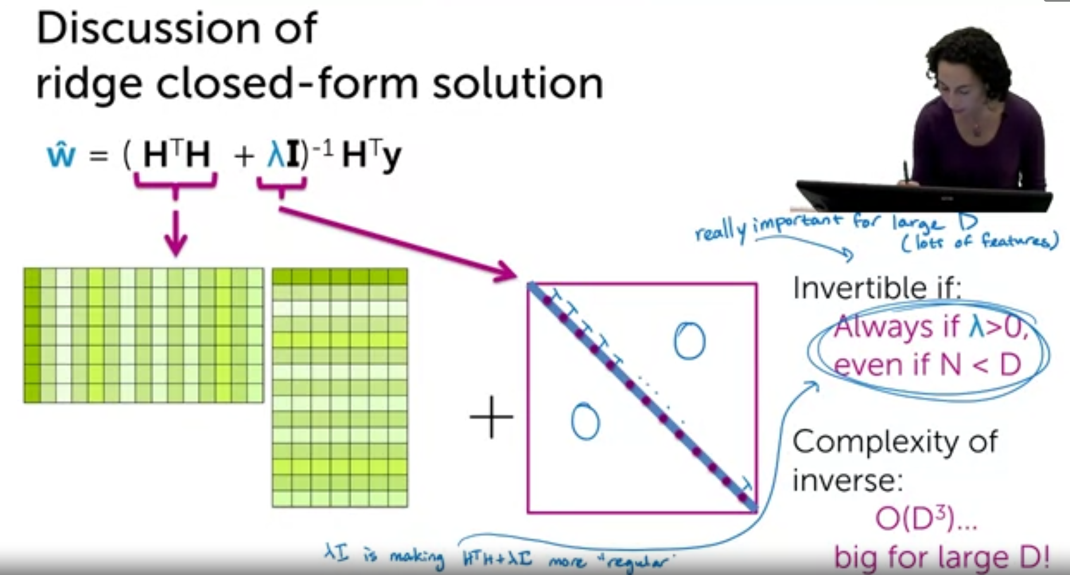

Slide 6
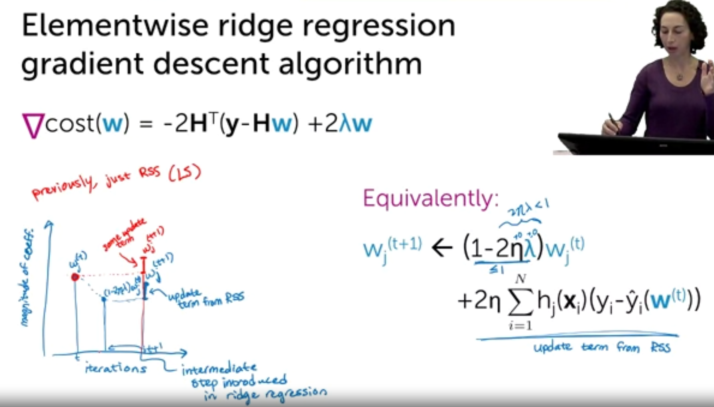
Technique: Plot the magnitude of coeff by iterations

Slide 7
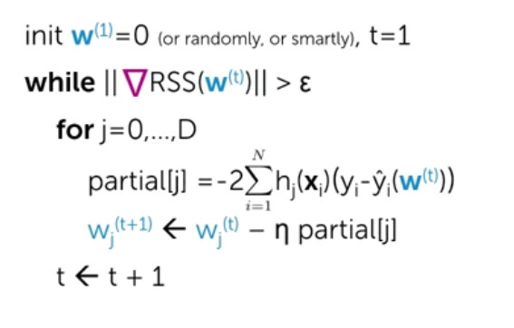
L2 regularization - algorithm pseudo

Slide 8
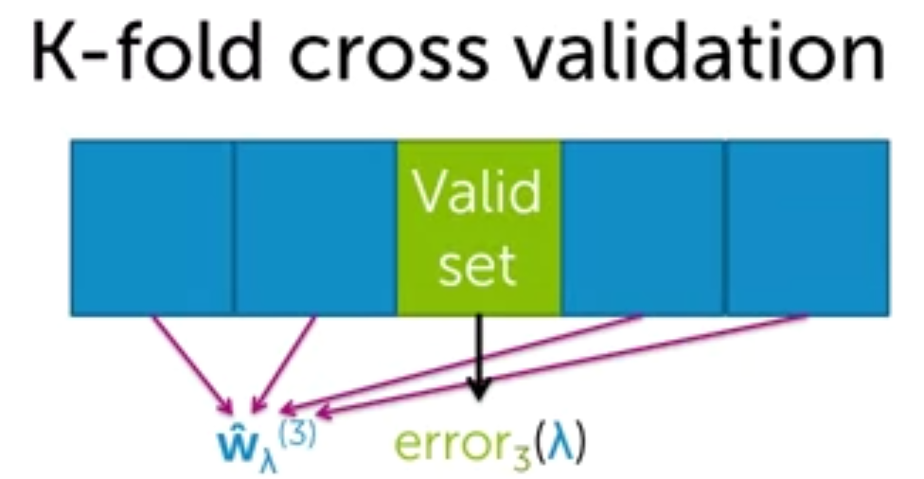
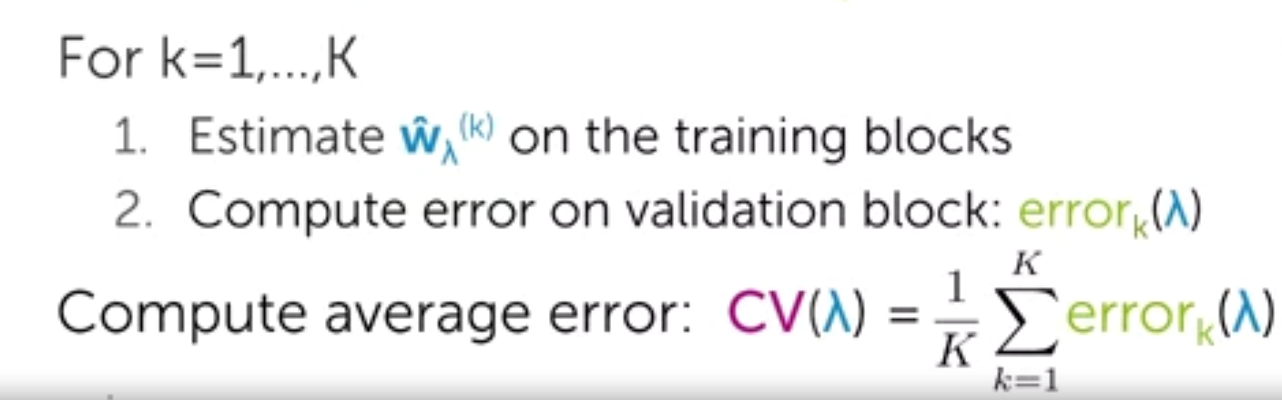
For each lambda value across lambda 1 - n:
Split data into k-fold
For each k-fold,
Use k-1 fold for training
Use gradient descent algorithm to get w (wj)
For all feature d, calculate partial w and sum of square error
Stop until the total sum of square error is very small
Use 1 (j) fold for validation, and get error (ej)
Get average error from 1 to k fold

